Slide 1

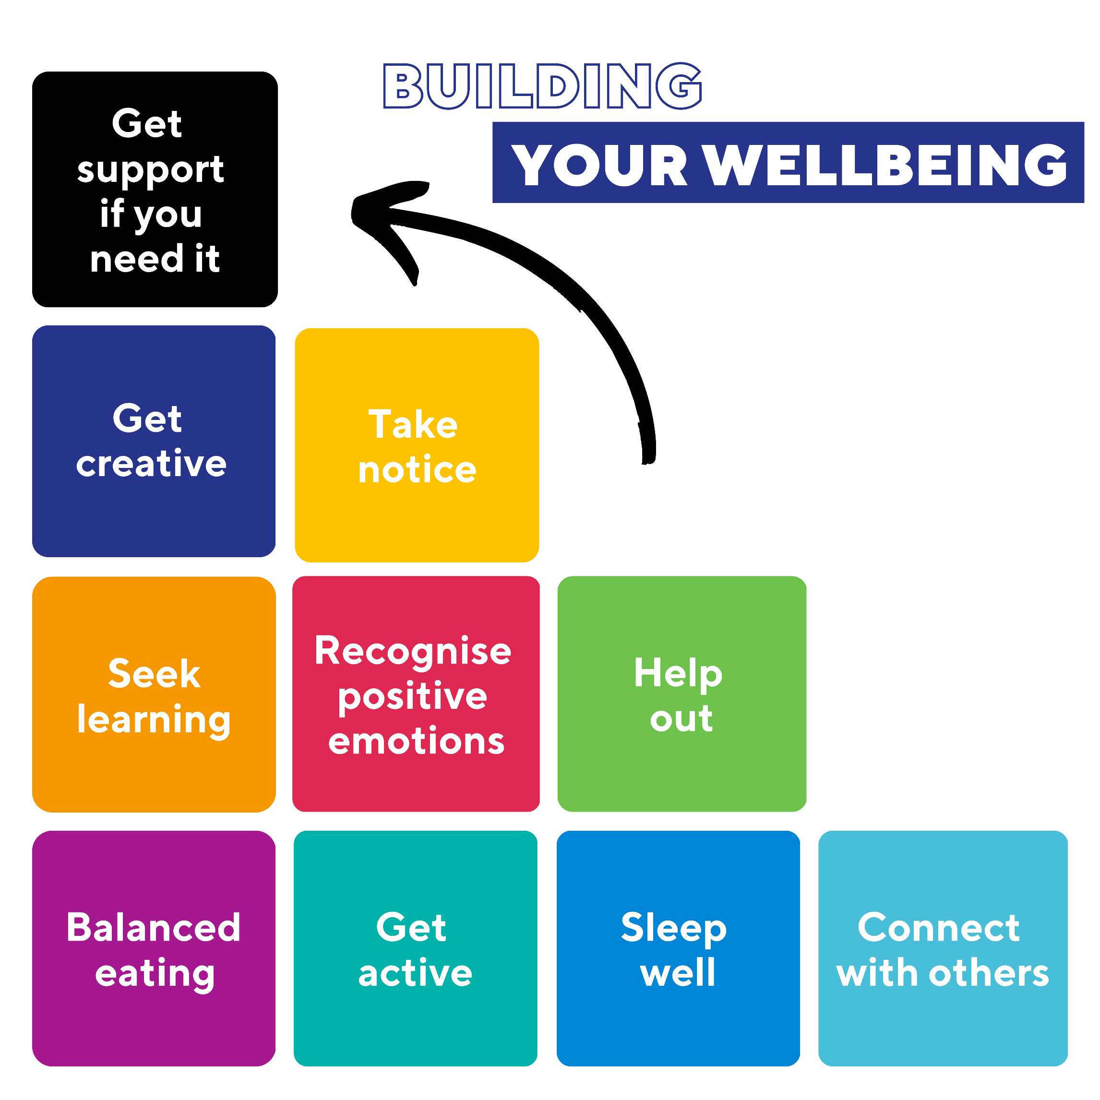


Your Success
and Wellbeing Services
Build wellbeing skills
Learn how to be at your best and help others through free workshops and opportunities
Counselling
Book online for free, private and confidential counselling for a range of issues
Financial Help Apply to loan or own a laptop or access financial help for severe financial hardship
The Living Room
Feeling stressed or lonely? Drop in to Shenton House and chat with a Peer Supporter between 11am-4pm, no appointment
International Student Support & International Student Lounge
Come and visit us in Shenton House if you need to speak to a team member or meet other international students
BOOKMARK YOUR SERVICES DIRECTORY
Notes:
There are a range of UWA support services available at no cost or low cost.
These services are accredited, confidential, and not linked with your academic profile or your visa to study in Australia.
If you are not enrolled at UWA, you can access the counselling and medical services at your enrolled university.

Slide 2

Your Success
and Wellbeing Services
Accessibility support Explore learning adjustments for a physical or mental health condition or disability affecting your studies
Security 24/7 assistance and security escorts to car parks and College Row. Download the Safe Zone App
Academic skills
Get advice, one-on-one support and workshops to improve your skills in academic writing, study, English language, research, maths and stats
Health and Medical Services Book online for an appointment with a GP (doctor). Bulk billed for domestic, OSHC covered for international students. Medibank are our preferred provider
Support for Sexual Assault and Harassment Access confidential support from a specialist about safety, academic, wellbeing and reporting options
BOOKMARK YOUR SERVICES DIRECTORY
Notes:
There are a range of UWA support services available at no cost or low cost.
These services are accredited, confidential, and not linked with your academic profile or your visa to study in Australia.
If you are not enrolled at UWA, you can access the counselling and medical services at your enrolled university.

